Slide 1
L05 Poisson Distribution
Concepts
E214 – Statistical Methods for Engineering

Slide 2
E214 – Statistical Methods for Engineering
Inferential Statistics
Hypothesis Testing
Parameter Estimation
Organise & summarise data collected
Probability and Distributions
Venn Diagram
Probability Distributions
Descriptive Statistics
Tree Diagram
Discrete Random Variables and Probability Distributions
Continuous Random Variables and Probability Distributions
Binomial Distribution
Poisson Distribution
Normal Distribution
Exponential Distribution
A more detailed topic tree on Hypothesis Testing will be given from L08 onwards
L05

Slide 3
Overview of Concepts
S/N | Concepts | Slide Number
1 | Poisson Random Variable | 4-5
2 | Poisson Distribution | 6-7
3 | Poisson Distribution vs Binomial Distribution | 8
4 | PMF for Poisson Distribution and calculation of probabilities using Excel | 9-10
5 | Mean, Variance, Standard Deviation, Mode of Poisson Random Variable | 11
6 | Examples | 12-18
7 | Poisson Approximation to Binomial Distribution | 19-20
8 | Summary of learning objectives for L05 | 21
9 | E-learning video for L05 | 22

Slide 4
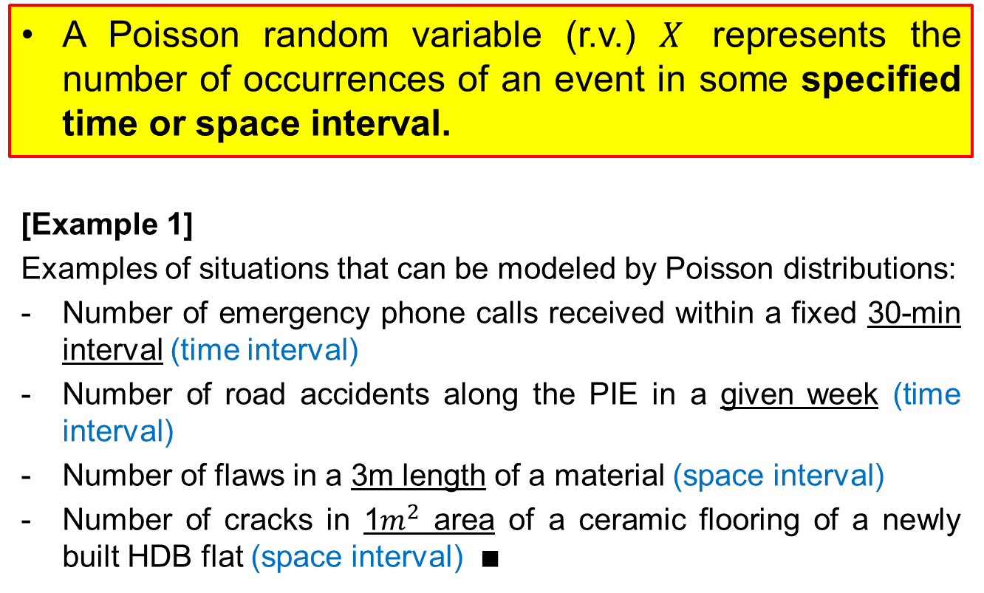
Poisson Random Variable
A Poisson random variable (r.v.) $X$ represents the number of occurrences of an event in some specified time or space interval.
[Example 1]
Examples of situations that can be modeled by Poisson distributions:
Number of emergency phone calls received within a fixed 30-min interval (time interval)
Number of road accidents along the PIE in a given week (time interval)
Number of flaws in a 3m length of a material (space interval)
Number of cracks in 1$m^{2}$ area of a ceramic flooring of a newly built HDB flat (space interval) $∎$

Slide 5
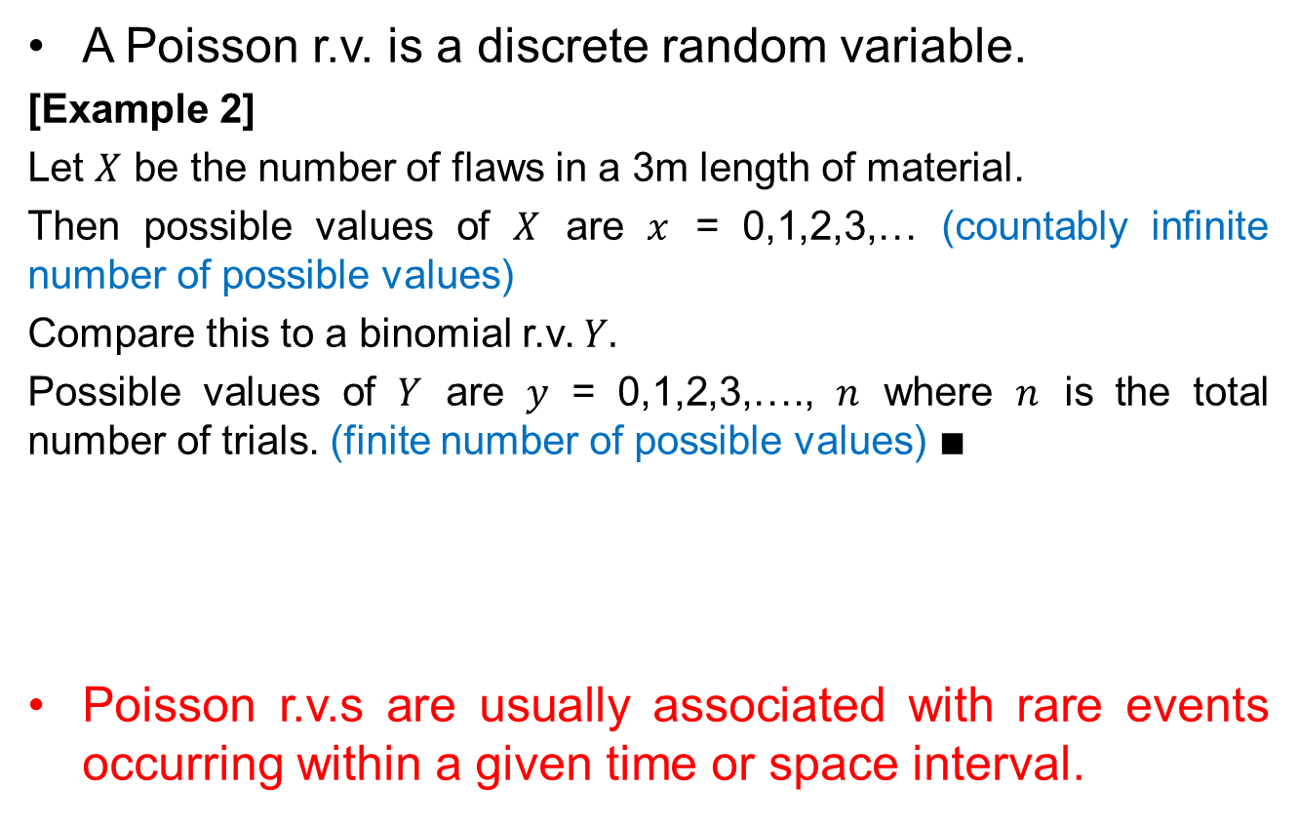
Poisson Random Variable
A Poisson r.v. is a discrete random variable.
[Example 2]
Let $X$ be the number of flaws in a 3m length of material.
Then possible values of $X$ are $x$ = 0,1,2,3,… (countably infinite number of possible values)
Compare this to a binomial r.v. $Y.$
Possible values of $Y$ are $y$ = 0,1,2,3,…., $n$ where $n$ is the total number of trials. (finite number of possible values) $∎$
Poisson r.v.s are usually associated with rare events occurring within a given time or space interval.
Poisson r.v.s have countably infinite number of possible values, while binomial r.v.s have a finite number of possible values. This is how we can distinguish the two.

Slide 6
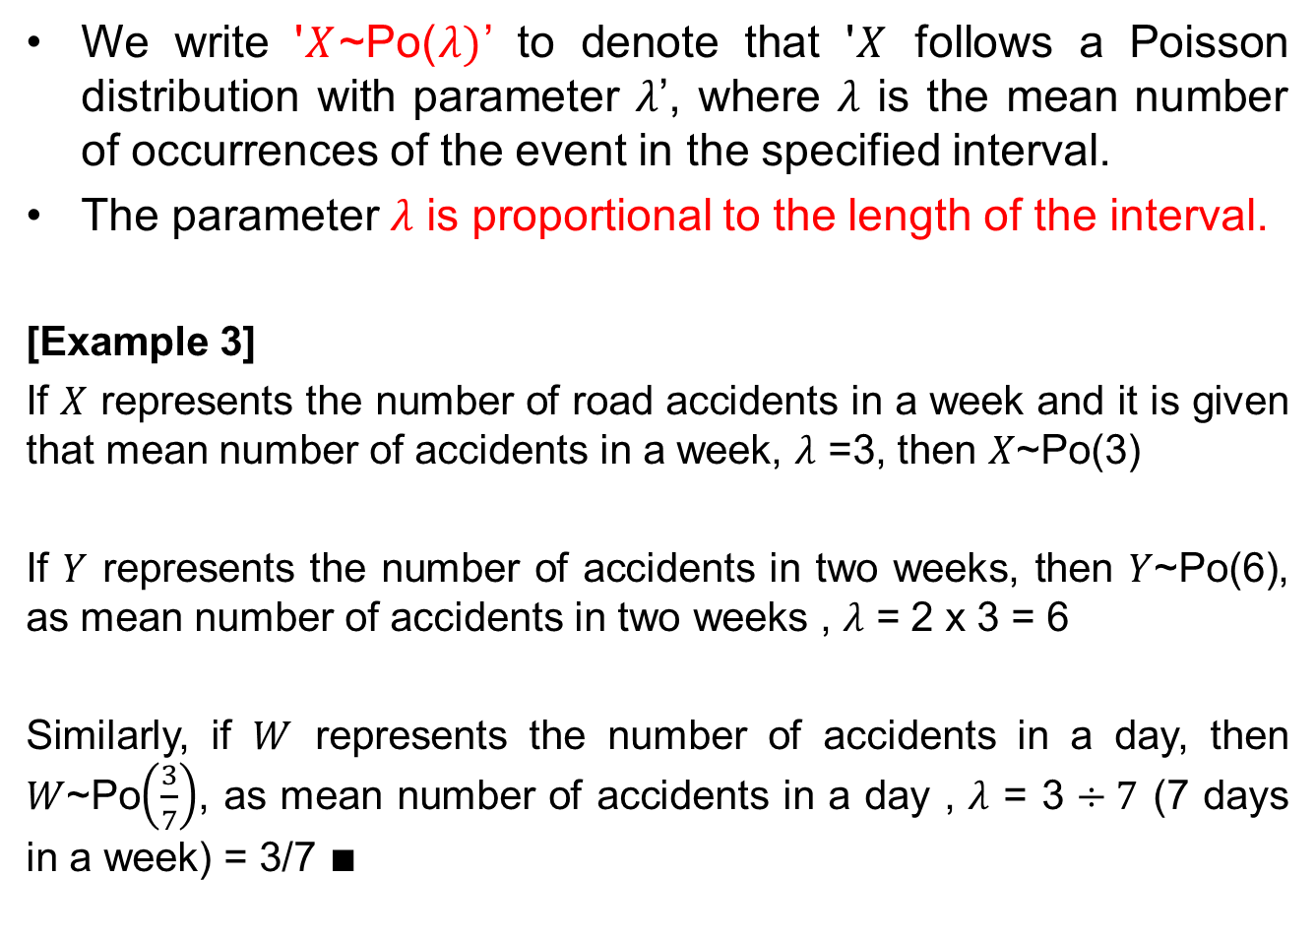
Poisson Distribution
We write '$X$~Po($λ)$’ to denote that '$X$ follows a Poisson distribution with parameter $λ$’, where $λ$ is the mean number of occurrences of the event in the specified interval.
The parameter $λ$ is proportional to the length of the interval.
[Example 3]
If $X$ represents the number of road accidents in a week and it is given that mean number of accidents in a week, $λ$ =3, then $X$~Po(3)
If $Y$ represents the number of accidents in two weeks, then $Y$~Po(6), as mean number of accidents in two weeks , $λ$ = 2 x 3 = 6
Similarly, if $W$ represents the number of accidents in a day, then $W$~Po$\left(\frac{3}{7}\right)$, as mean number of accidents in a day , $λ$ = 3 $÷7$ (7 days in a week) = 3/7 $∎$

Slide 7
Conditions to Apply Poisson Distribution
The following conditions should be fulfilled before using a Poisson distribution to model a practical situation:
Events occur randomly within the continuous space or time interval
Events occur independently in any disjoint and small space or time interval, i.e. the process has no ‘memory’
Mean number of occurrences of the event in the time or space interval is constant and known, and proportional to the length of the interval
The probability that a single event will occur during a very small time or space interval is a very small constant value
(v) The probability that two or more events will occur during a very small time or space interval is negligible (i.e. events occur singly)

Slide 8
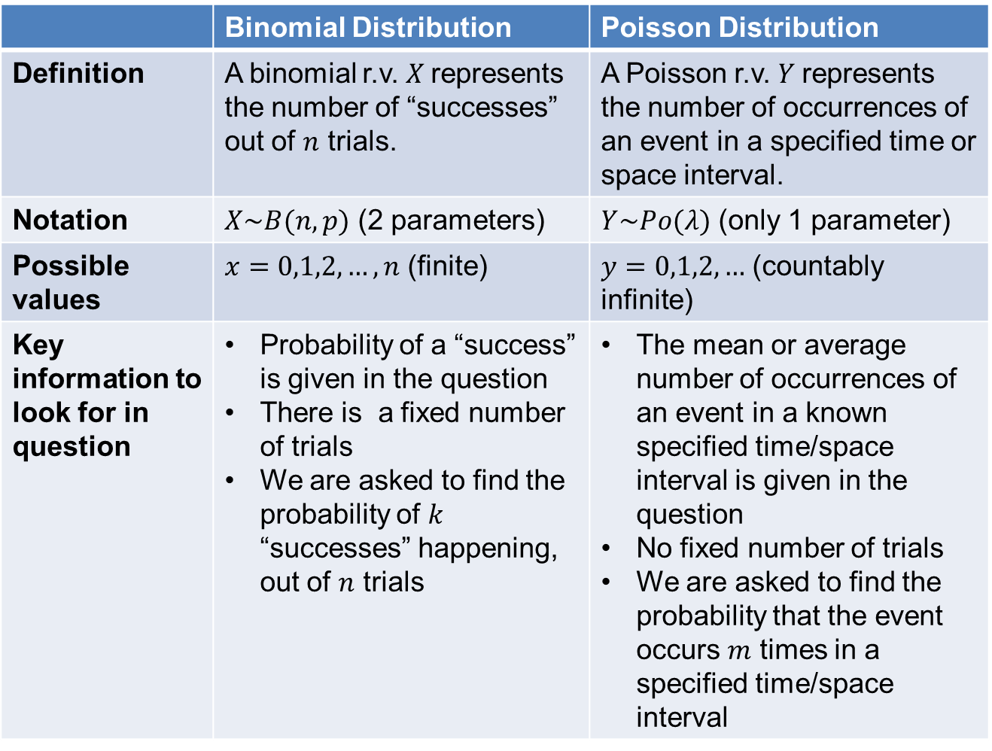
Poisson Distribution vs Binomial Distribution
 | Binomial Distribution | Poisson Distribution
Definition | A binomial r.v. $X$represents the number of “successes” out of $n$ trials. | A Poisson r.v. $Y$represents the number of occurrences of an event in a specified time or space interval.
Notation | $X\sim B(n,p)$ (2 parameters) | $Y\sim Po(λ)$ (only 1 parameter)
Possible values | $x=0,1,2,…,n$ (finite) | $y=0,1,2,…$ (countably infinite)
Key information to look for in question | Probability of a “success” is given in the question There is a fixed number of trials We are asked to find the probability of $k$ “successes” happening, out of $n$ trials | The mean or average number of occurrences of an event in a known specified time/space interval is given in the question No fixed number of trials We are asked to find the probability that the event occurs $m$ times in a specified time/space interval

Slide 9
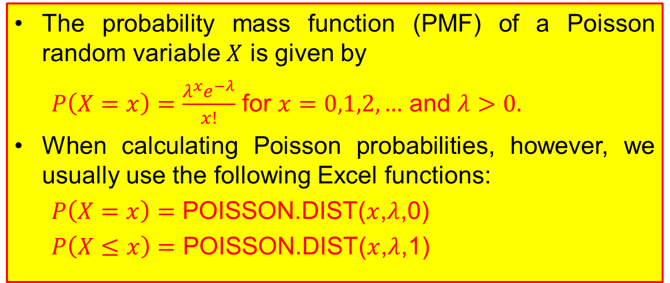
PMF for Poisson Distribution
The probability mass function (PMF) of a Poisson random variable $X$ is given by
$P\left(X=x\right)=\frac{λ^{x}e^{−λ}}{x!}$ for $x=0,1,2,…$ and $λ>0.$
When calculating Poisson probabilities, however, we usually use the following Excel functions:
$P\left(X=x\right)=$ POISSON.DIST($x$,$λ$,0)
$P\left(X≤x\right)=$ POISSON.DIST($x$,$λ$,1)

Slide 10
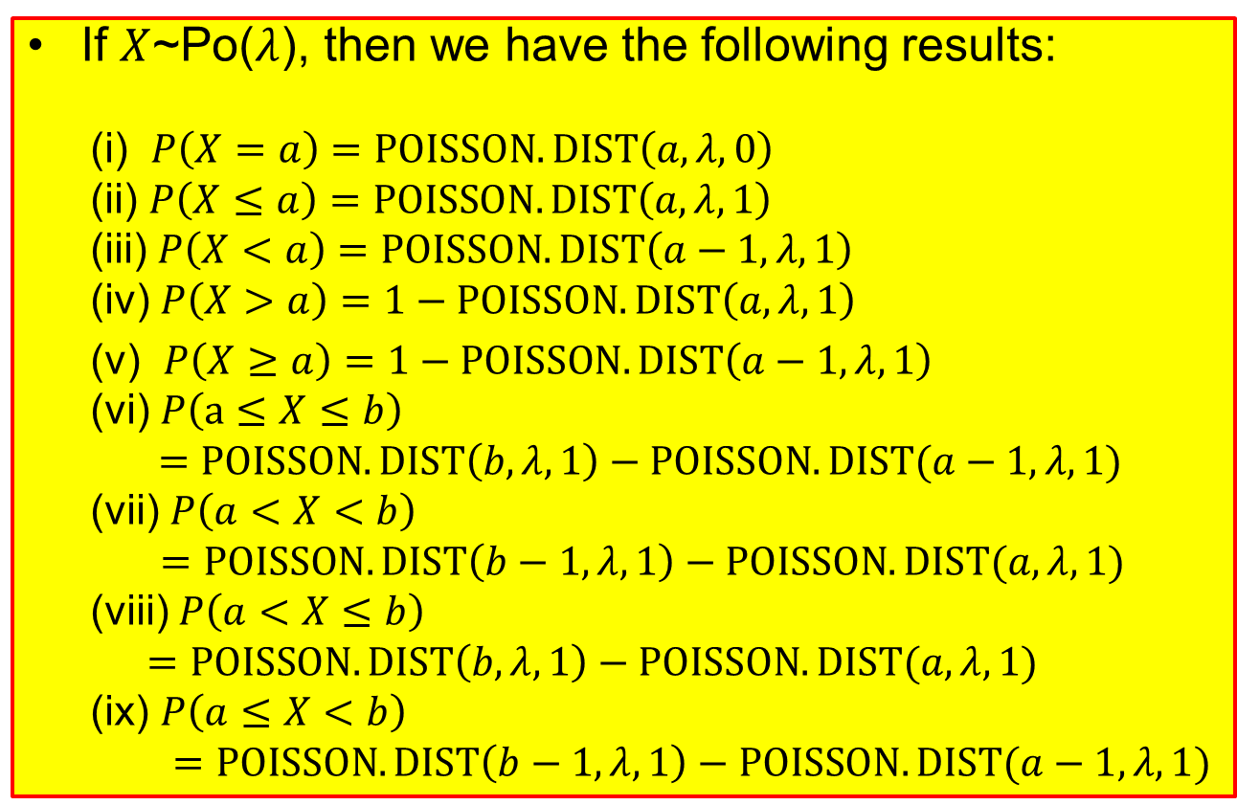
Calculation of Probabilities using the Poisson Distribution
If $X$~Po($λ$), then we have the following results:
(i) $P\left(X=a\right)=POISSON.DIST\left(a,λ,0\right)$
(ii) $P\left(X≤a\right)=POISSON.DIST\left(a,λ,1\right)$
(iii) $P\left(X<a\right)=POISSON.DIST\left(a−1,λ, 1\right)$
(iv) $P\left(X>a\right)=1−POISSON.DIST\left(a,λ,1\right)$
(v) $P\left(X≥a\right)=1−POISSON.DIST\left(a−1,λ, 1\right)$
(vi) $P\left(a≤X≤b\right)$
$=POISSON.DIST\left(b,λ, 1\right)−POISSON.DIST(a−1,λ, 1)$
(vii) $P\left(a<X<b\right)$
$=POISSON.DIST\left(b−1,λ, 1\right)−POISSON.DIST(a,λ, 1)$
(viii) $P\left(a<X≤b\right)$
$$=POISSON.DIST\left(b,λ, 1\right)−POISSON.DIST(a,λ, 1)$$
(ix) $P\left(a≤X<b\right)$
$=POISSON.DIST\left(b−1,λ, 1\right)−POISSON.DIST(a−1,λ, 1)$

Slide 11

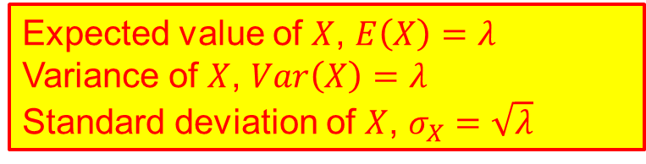
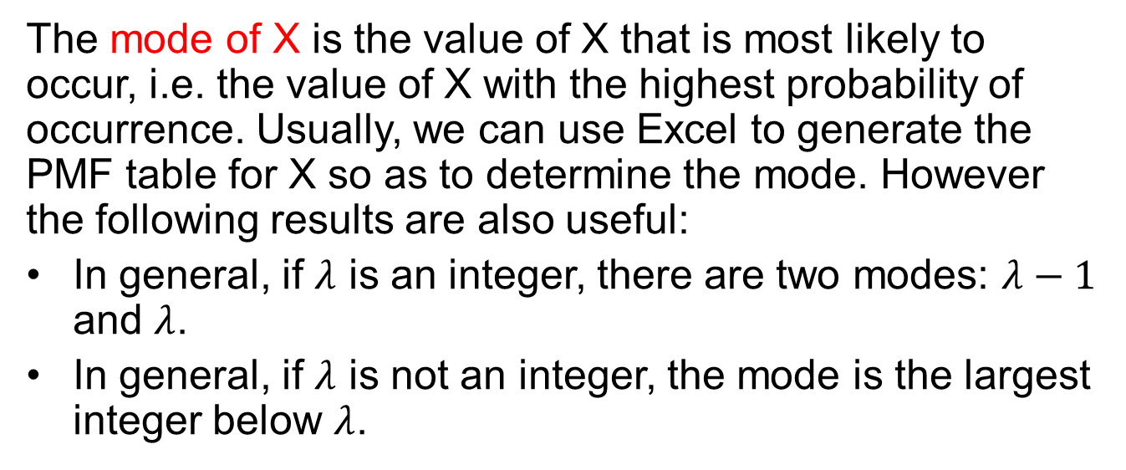
Mean, Variance, Standard Deviation, Mode of Poisson Random Variable
Let $X$ be a Poisson random variable representing the number of occurrences of an event in a specified interval (of time or space). i.e. $X$~Po($λ$).
Expected value of $X$, $E\left(X\right)=λ$
Variance of $X$, $Var\left(X\right)=λ$
Standard deviation of $X$, $σ_{X}=\sqrt{λ}$
The mode of X is the value of X that is most likely to occur, i.e. the value of X with the highest probability of occurrence. Usually, we can use Excel to generate the PMF table for X so as to determine the mode. However the following results are also useful:
In general, if $λ$ is an integer, there are two modes: $λ−1$ and $λ$.
In general, if $λ$ is not an integer, the mode is the largest integer below $λ$.
Notes:
Lecturer to consider providing examples using Excel to demonstrate the concept of mode:
Poisson variable with lambda of 5 (modes would be 4 and 5)
Poisson variable with lambda of 5.2 (mode would be 5)
Poisson variable with lambda of 5.9 (mode would be 5; prove that always round DOWN)

Slide 12
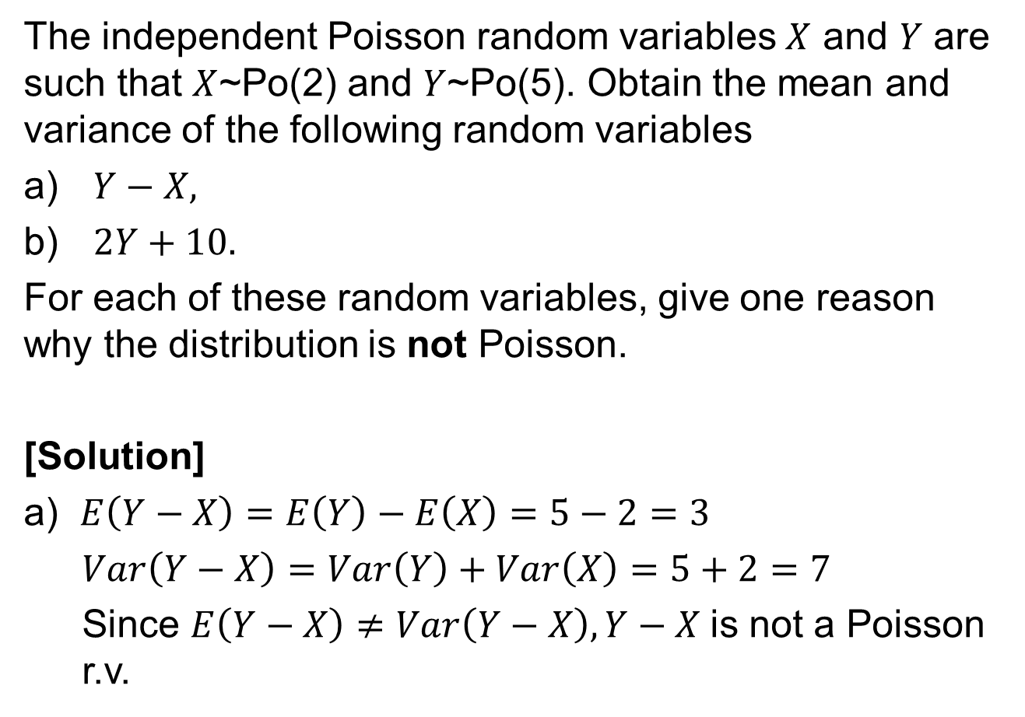
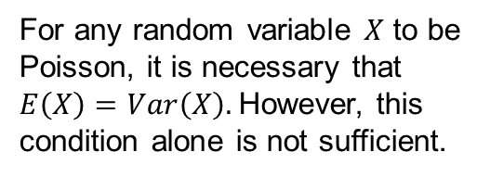
Example 4
The independent Poisson random variables $X$ and $Y$ are such that $X$~Po(2) and $Y$~Po(5). Obtain the mean and variance of the following random variables
$Y−X,$
$2Y+10.$
For each of these random variables, give one reason why the distribution is not Poisson.
[Solution]
a) $E\left(Y−X\right)=E\left(Y\right)−E\left(X\right)=5−2=3$
$Var\left(Y−X\right)=Var\left(Y\right)+Var\left(X\right)=5+2=7$
Since $E\left(Y−X\right)≠Var\left(Y−X\right), Y−X$is not a Poisson r.v.
For any random variable $X$ to be Poisson, it is necessary that $E\left(X\right)=Var\left(X\right).$However, this condition alone is not sufficient.

Slide 13
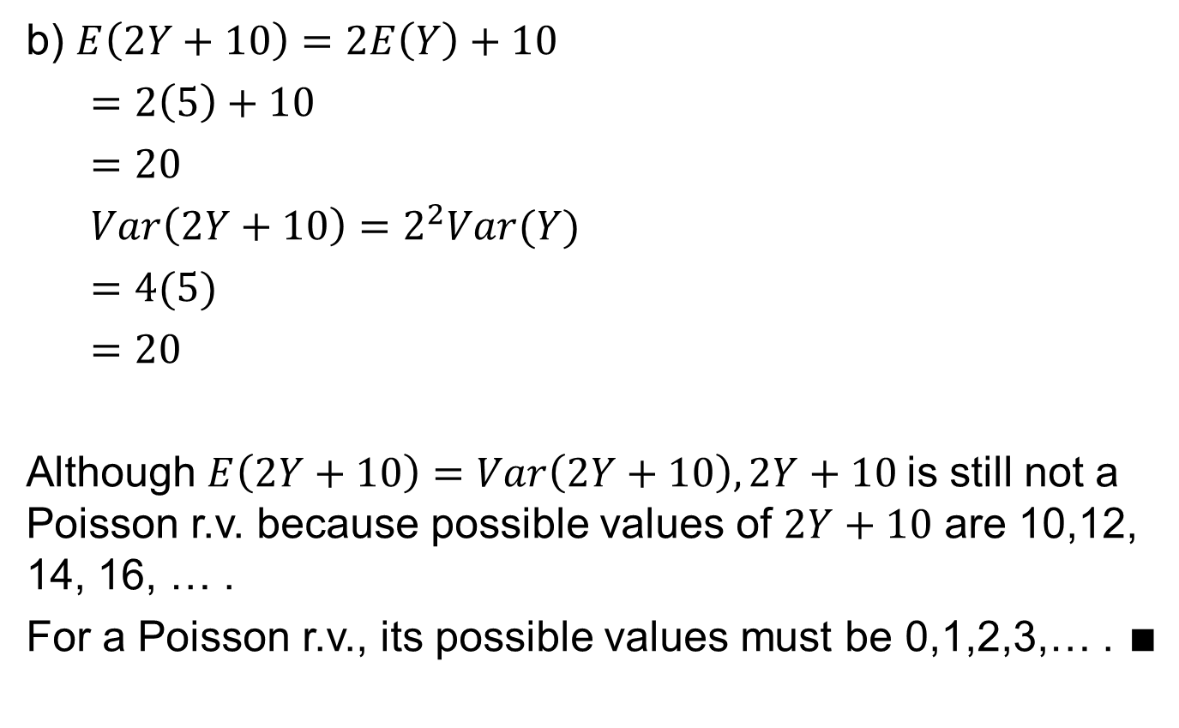
Example 4
b) $E\left(2Y+10\right)=2E\left(Y\right)+10$
$=2\left(5\right)+10$
$=20$
$Var\left(2Y+10\right)=2^{2}Var(Y)$
$=4(5)$
$=20$
Although $E\left(2Y+10\right)=Var\left(2Y+10\right), 2Y+10$is still not a Poisson r.v. because possible values of $2Y+10$ are 10,12, 14, 16, … .
For a Poisson r.v., its possible values must be 0,1,2,3,… . $∎$

Slide 14
Example 5
The number of emergency calls received by a fire station in a randomly chosen month can be modelled by a Poisson distribution with mean 2.5.
Find the probability that in a randomly chosen year, the number of emergency calls received is:
at least 20,
between 20 and 40, and
between 20 and 40 (inclusive).
Find also the most likely number of calls received in a year.

Slide 15

Example 5 - Solution
Let $X$ be the number of emergency calls received in one year.
$X$~Po(2.5*12)
$X$~Po(30)
a) $P(X≥20)$
= 1- POISSON.DIST(19, 30, 1)
= 0.978
b) $P(20<X<40)$
= POISSON.DIST(39, 30, 1) – POISSON.DIST(20, 30,1)
= 0.918
Framework for solving Distribution Problems:
Define the Poisson random variable.
State the Poisson distribution with its parameter value.
Solve the problem.

Slide 16
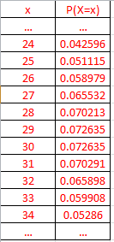
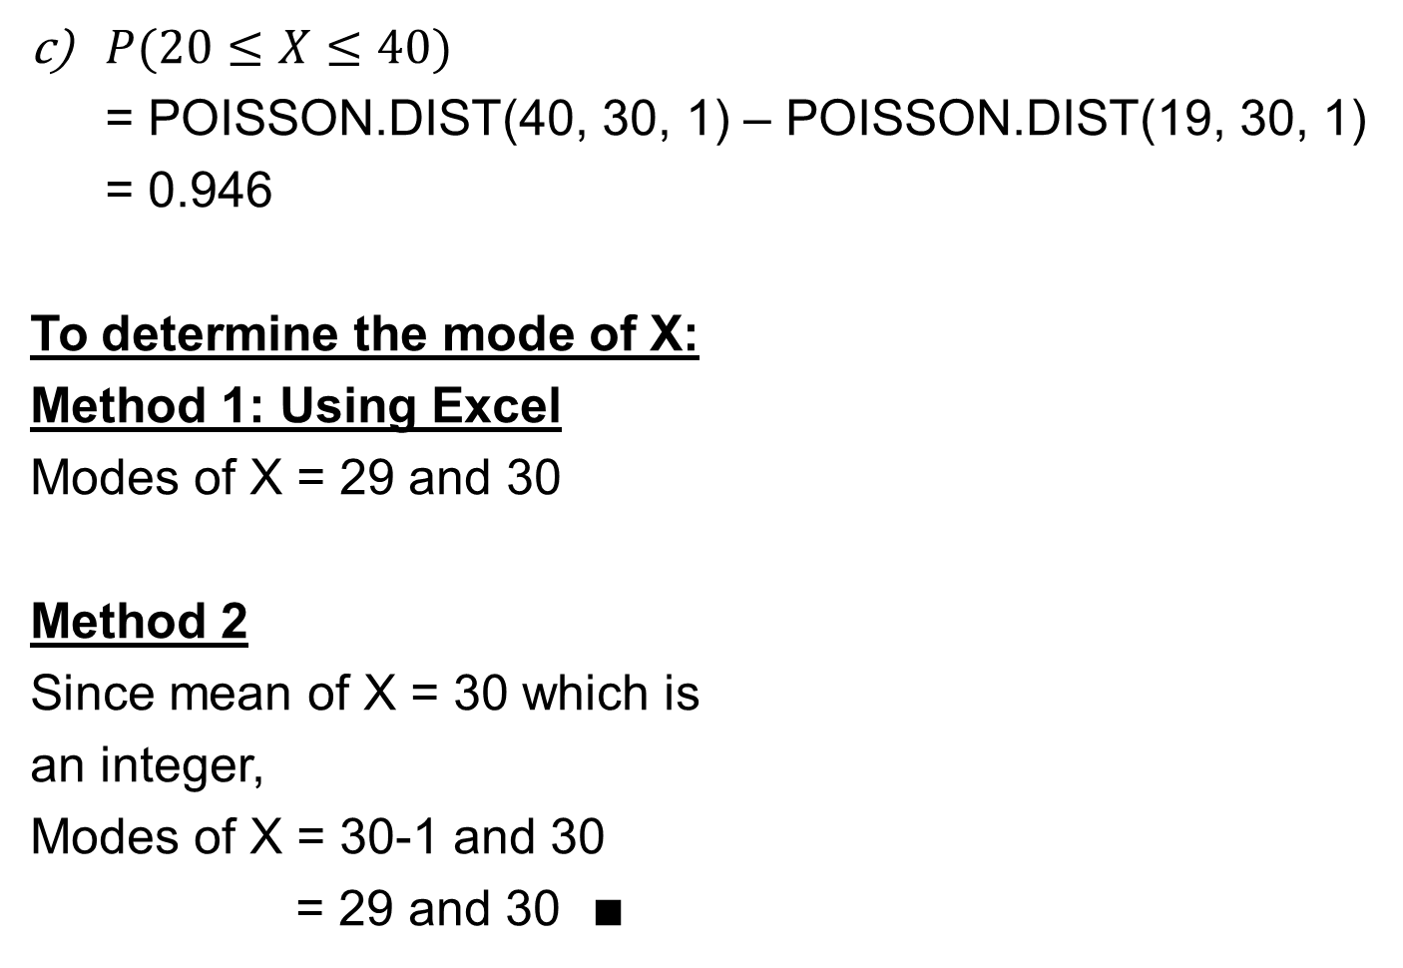
Example 5 - Solution
$P(20≤X≤40)$
= POISSON.DIST(40, 30, 1) – POISSON.DIST(19, 30, 1)
= 0.946
To determine the mode of X:
Method 1: Using Excel
Modes of X = 29 and 30
Method 2
Since mean of X = 30 which is
an integer,
Modes of X = 30-1 and 30
= 29 and 30 $∎$

Slide 17
Example 6
Over a period of 100 days, the number of deaths reported in a local newspaper are as follows:
Determine the probability that there are at least 4 deaths reported in a day.
No. of deaths in a day | 0 | 1 | 2 | 3 | 4 | 5 | 6 or over
No. of days | 26 | 37 | 20 | 11 | 5 | 1 | 0

Slide 18
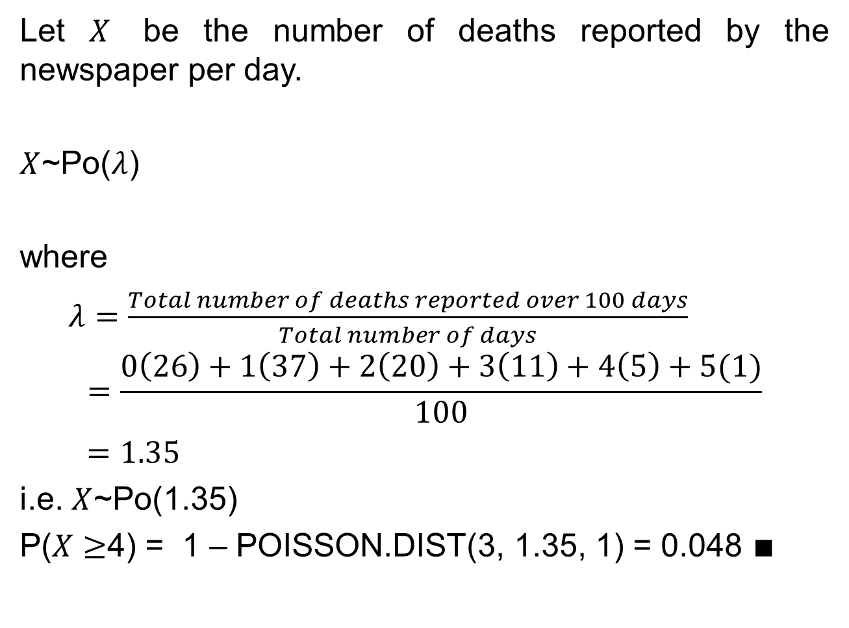
Example 6 - Solution
Let $X$ be the number of deaths reported by the newspaper per day.
$X$~Po($λ$)
where
$λ=\frac{Total number of deaths reported over 100 days}{Total number of days}$
$$=\frac{0\left(26\right)+1\left(37\right)+2\left(20\right)+3\left(11\right)+4\left(5\right)+5(1)}{100}$$
$=1.35$
i.e. $X$~Po(1.35)
P($X≥$4) = 1 – POISSON.DIST(3, 1.35, 1) = 0.048 $∎$
Framework for solving Distribution Problems:
Define the Poisson random variable.
State the Poisson distribution with its parameter value.
Solve the problem.

Slide 19

Poisson Approximation to the Binomial Distribution
If $X$ follows a binomial distribution, i.e. $X$~B($n$,$p$) and if $n$ is large and $p$ is small, and $np$ is moderate, then $X$ can be approximated by a Poisson distribution with mean $np$,
i.e. $X$ ~ Po($np$) approximately.
A few general rules-of-thumb:
n≥20 and p≤0.1, or
n≥100 and np≤10 or
n ≥ 50, p is small (<0.1)
and np <= 5
So…
How large should n be?
How small should p be?
Why is it important to use a Poisson distribution to approximate the Binomial distribution?
Imagine if there are no Excel functions available, the probability calculation using a Poisson distribution would be much more convenient to compute than using a Binomial distribution.

Slide 20
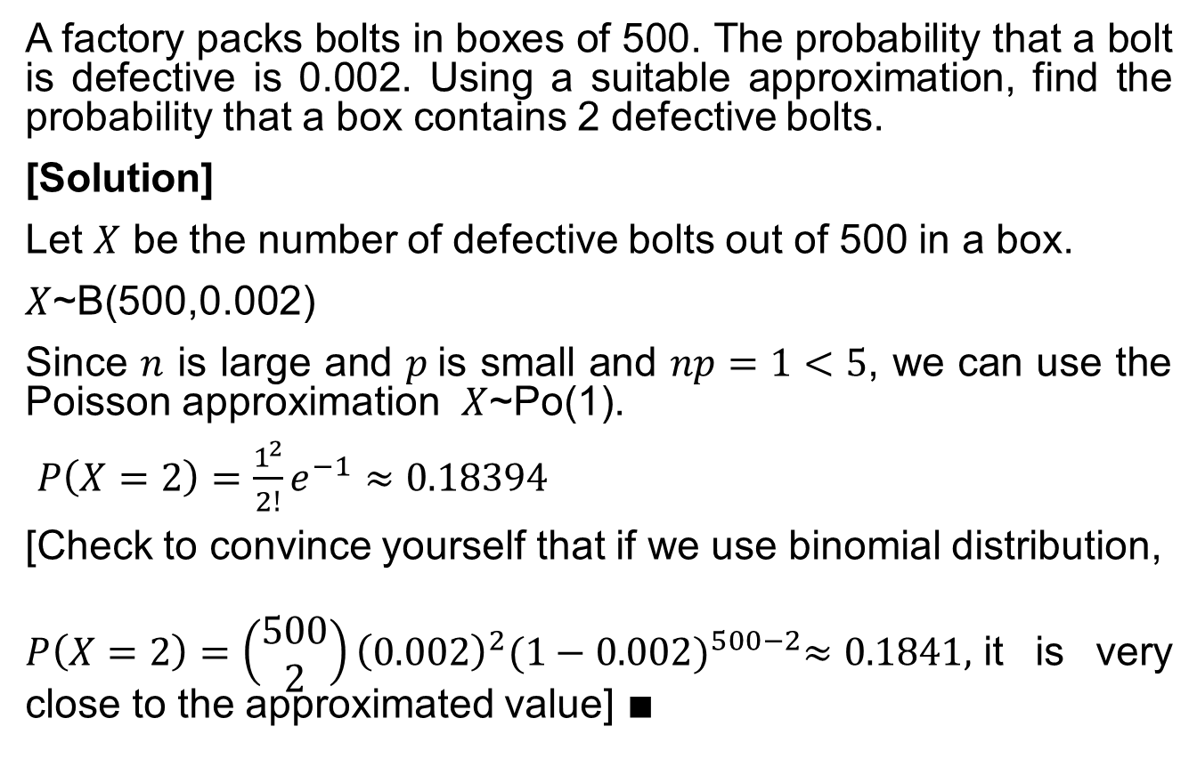
Example 7
A factory packs bolts in boxes of 500. The probability that a bolt is defective is 0.002. Using a suitable approximation, find the probability that a box contains 2 defective bolts.
[Solution]
Let $X$ be the number of defective bolts out of 500 in a box.
$X$~B(500,0.002)
Since $n$ is large and $p$is small and $np=1<5$, we can use the Poisson approximation $X$~Po(1).
$P\left(X=2\right)=\frac{1^{2}}{2!}e^{−1}≈0.18394$
[Check to convince yourself that if we use binomial distribution,
$P\left(X=2\right)=\left(\begin{matrix}500 \\ 2\end{matrix}\right){\left(0.002\right)}^{2}{(1−0.002)}^{500−2}≈0.1841,$it is very close to the approximated value] $∎$

Slide 21
Learning Objectives
Define a Poisson random variable
Describe the characteristics and properties of a Poisson distribution
Apply Poisson distribution model to calculate probabilities
Calculate the mean, variance and standard deviation of a Poisson random variable
Identify the similarities/differences between the Poisson and binomial random variables

Slide 22
E-Learning Video
You are strongly encouraged to watch the e-learning video prepared for L05 to enhance your understanding of the main learning objectives.
You can access the e-learning video from the following link:
https://drive.google.com/file/d/0B0VVo-P5cYtqYUVBQzJ3ZnVLN0U/edit?usp=sharing

